Slide 1
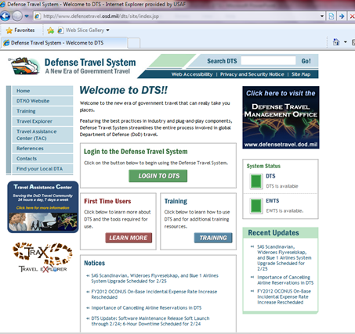
After your Return from Travel, Log into DTS. http://www.defensetravel.osd.mil/dts/site/index.jsp
Click LOGIN TO DTS

Slide 2
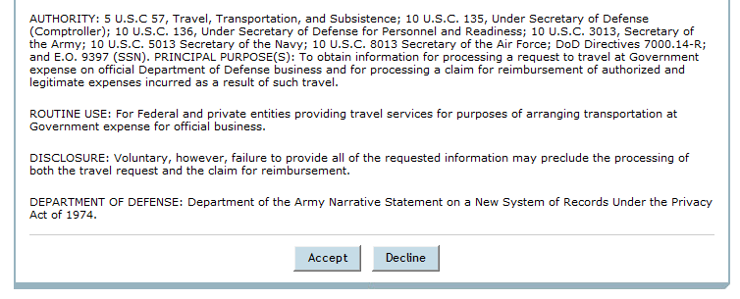
Once you have Clicked the Login Button, this Screen will Appear
Scroll down to the Bottom and click ACCEPT

Slide 3
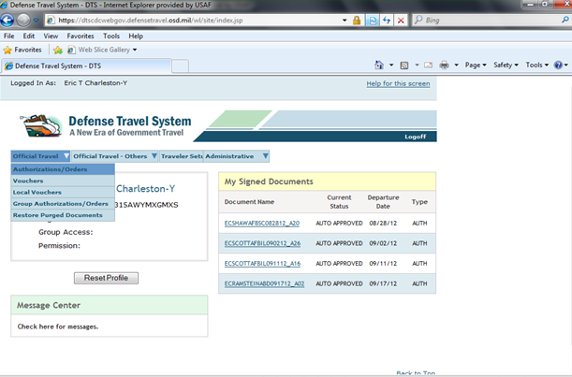
OFFICIAL TRAVEL
1
2
AUTH/ORDERS
1. Click on OFFICIAL TRAVEL
2. Click on AUTHORIZATIONS/ORDERS

Slide 4
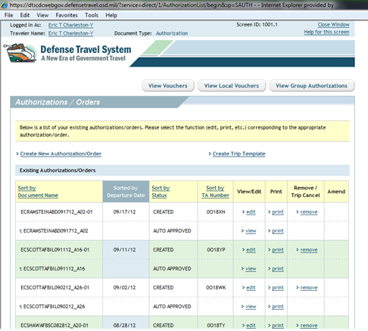
Two Lines will Appear with the same Information Pertaining to your Travel
Always work from the Line that you can Edit by Clicking EDIT

Slide 5
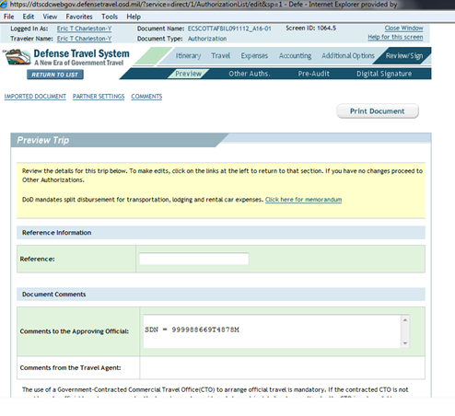
After you have clicked EDIT this Screen will Appear
This is a preview of your Entire Trip Based on the Information on your Orders
At the top of the page, Preview Trip Appears on the
Bottom Blue Bar

Slide 6
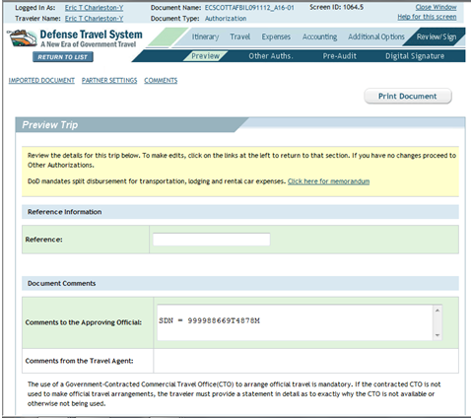
1
2
3
1. Select the REVIEW/SIGN Tab on the Top Blue Bar
2. The Preview Trip Screen will be Displayed
Scroll to Review the Trip Details
At the Bottom of the Page you will Click on 3. SAVE AND PROCEED TO OTHER AUTHS

Slide 7
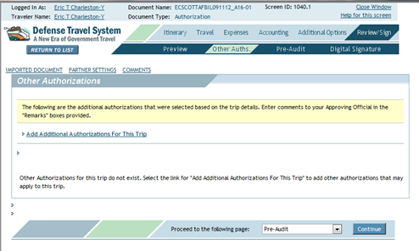
The Other Authorizations Screen will be Displayed

Slide 8
The Other Authorizations Screen will be Displayed
Click on the add additional authorization for this trip link.

Slide 9
Check the Other (see remarks blow box) and click on the add button

Slide 10
Add the following statement in the remarks block followed by specific justification for this TDY: “Alternate means, such as Secure Video Teleconference (SVTC) or other web based communications are not sufficient to accomplish travel objectives.” Followed by specific justification)
Select Save and Proceed to Pre-Audits

Slide 11
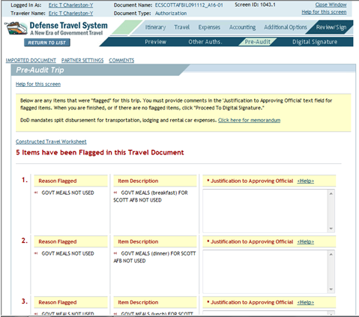
This Page Displays any Discrepancies that do not Match your Orders
Other Information may be Required (i.e, EFT info, etc.,)
Every flag Must be Addressed in the JUSTIFICATION TO APPROVING OFFICIAL box
To By-Pass Type: Authorized, Will be Submitted, etc.,
Click Save and Proceed to Digital Signature

Slide 12
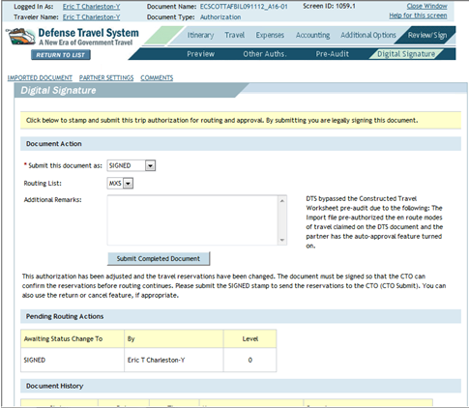
This Screen Displays Document Action
You are Submitting this Signed Document Stating all Information Provided is Correct
and Truthful
Click SUBMIT COMPLETED DOCUMENT
Once you Click the Button, you have Completed your Authorization for Travel
After your Supervisor’s Approval, you will be able to Create your Voucher in 24 Hours
You will Receive an Email when Approved

Slide 13
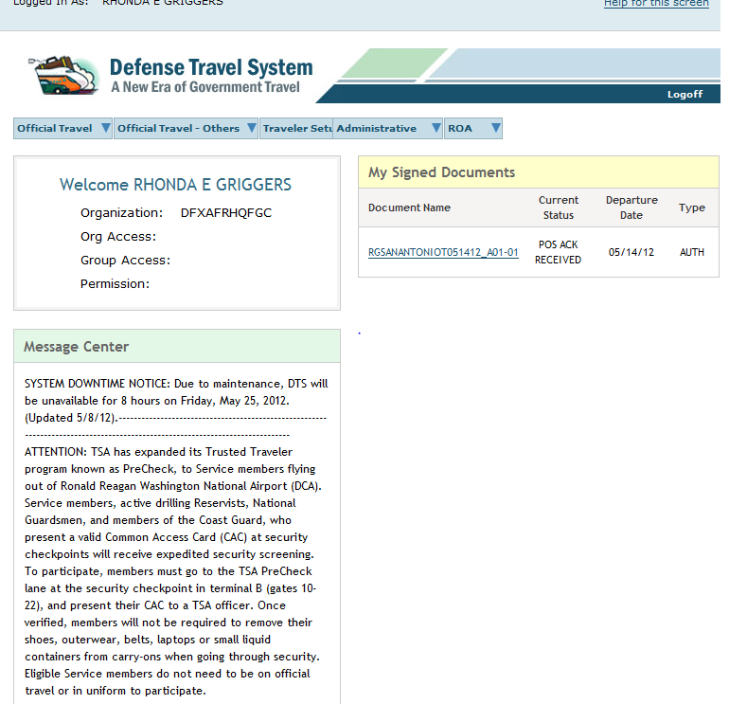
Creating your Voucher

Slide 14
To Create Your Voucher Log into DTS. http://www.defensetravel.osd.mil/dts/site/index.jsp
Click LOGIN TO DTS

Slide 15
Once you have Clicked the Login Button, this Screen will Appear
Scroll down to the Bottom and click ACCEPT

Slide 16
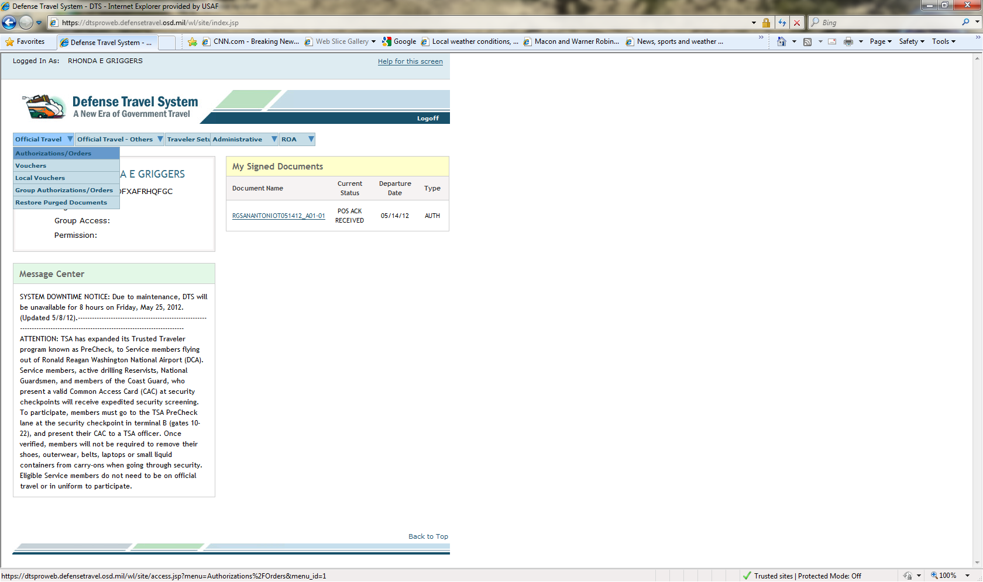
1
2
1. Select Official Travel
2. Select Authorizations

Slide 17
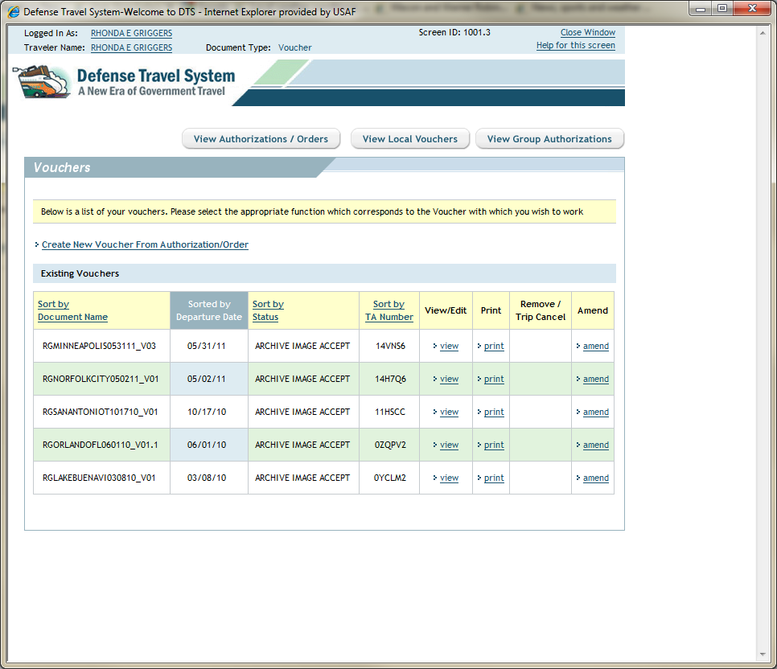
Click Create New Voucher From Authorization/Order

Slide 18
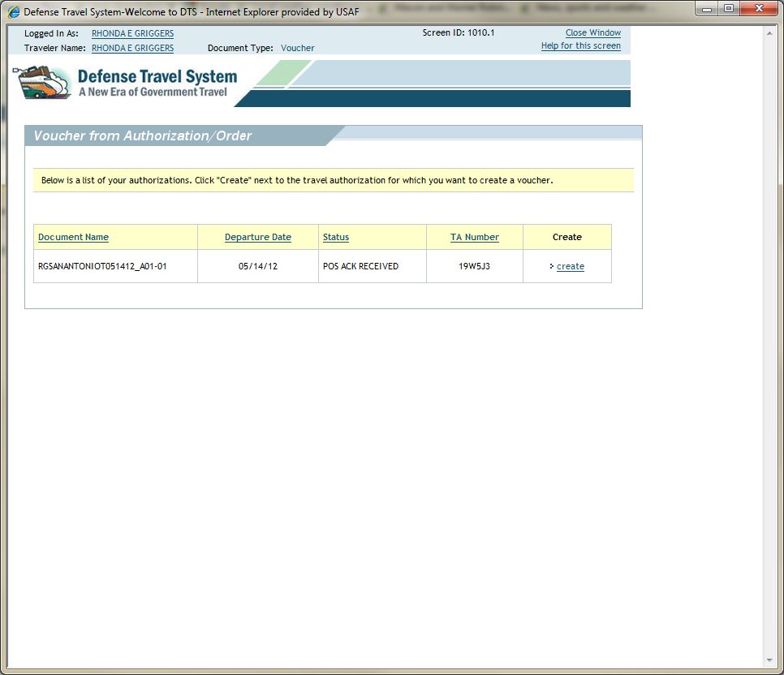
Click “create” to Create a Voucher

Slide 19
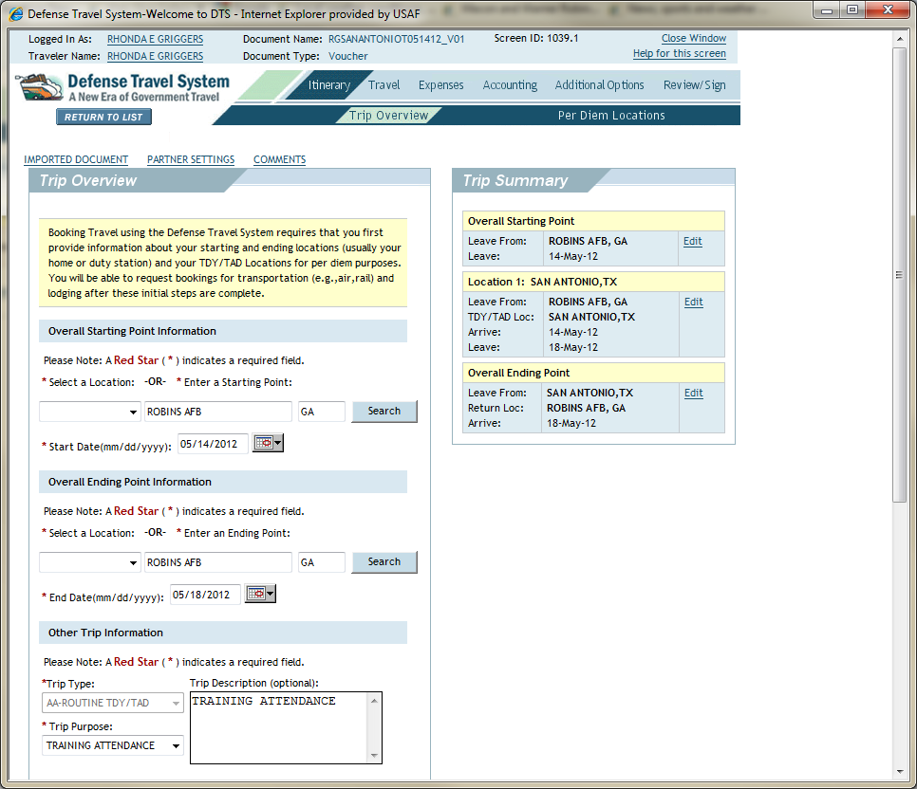
Your Trip Overview will Appear (flows from AROWS-R)

Slide 20
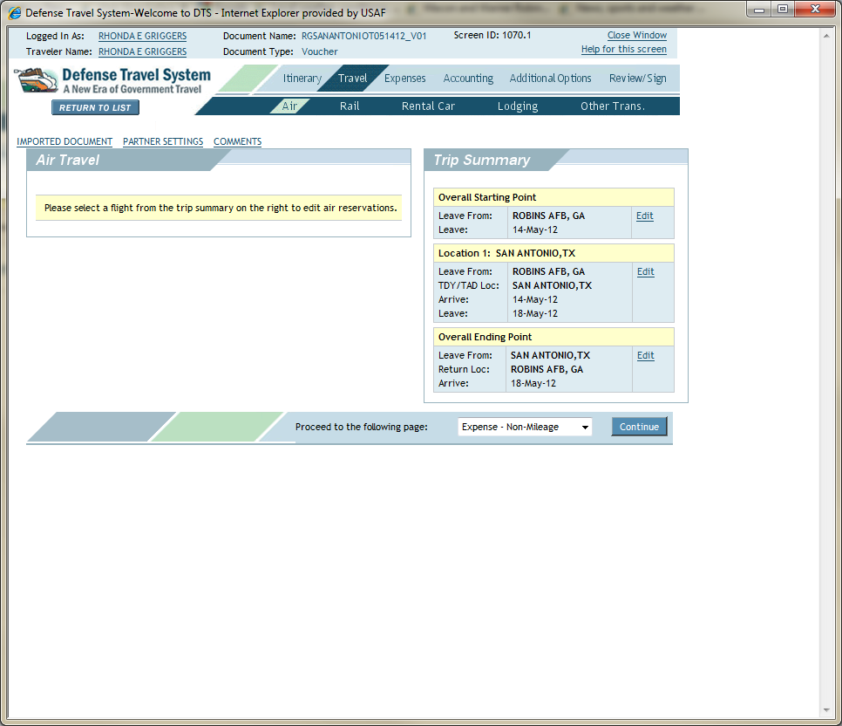
Click Travel
Notes:
20

Slide 21
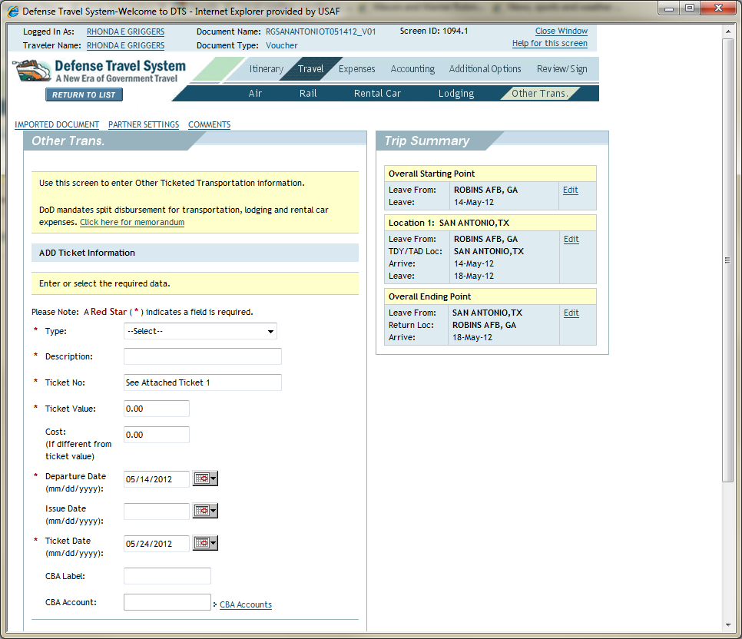
Click Other Transportation
Notes:
21

Slide 22
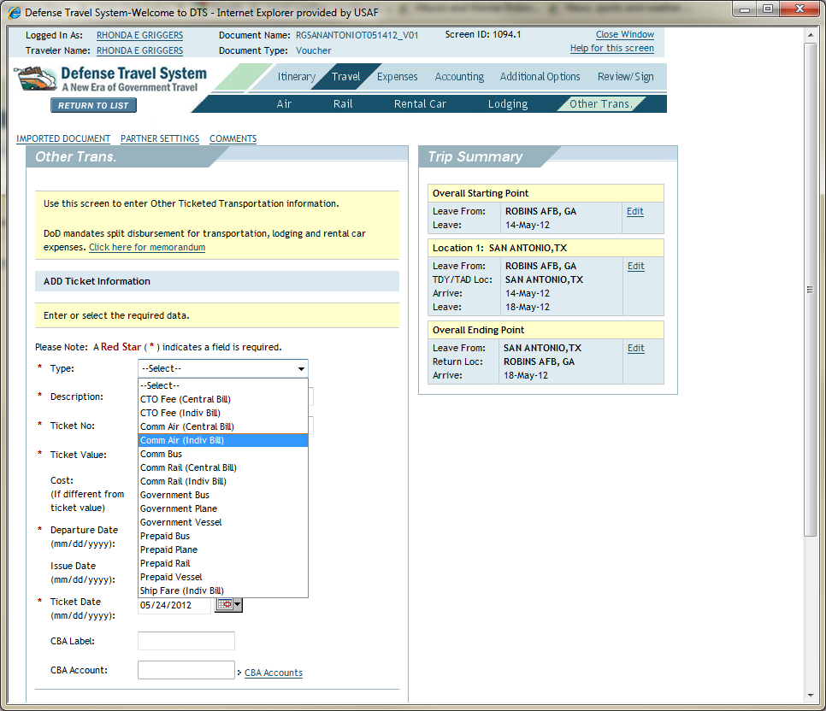
Select Commercial Air (Indiv Bill)
Traveler Used CTO office (Air Trak) and used the Government Travel Card (GTC), Individually Billed Account
Notes:
22

Slide 23
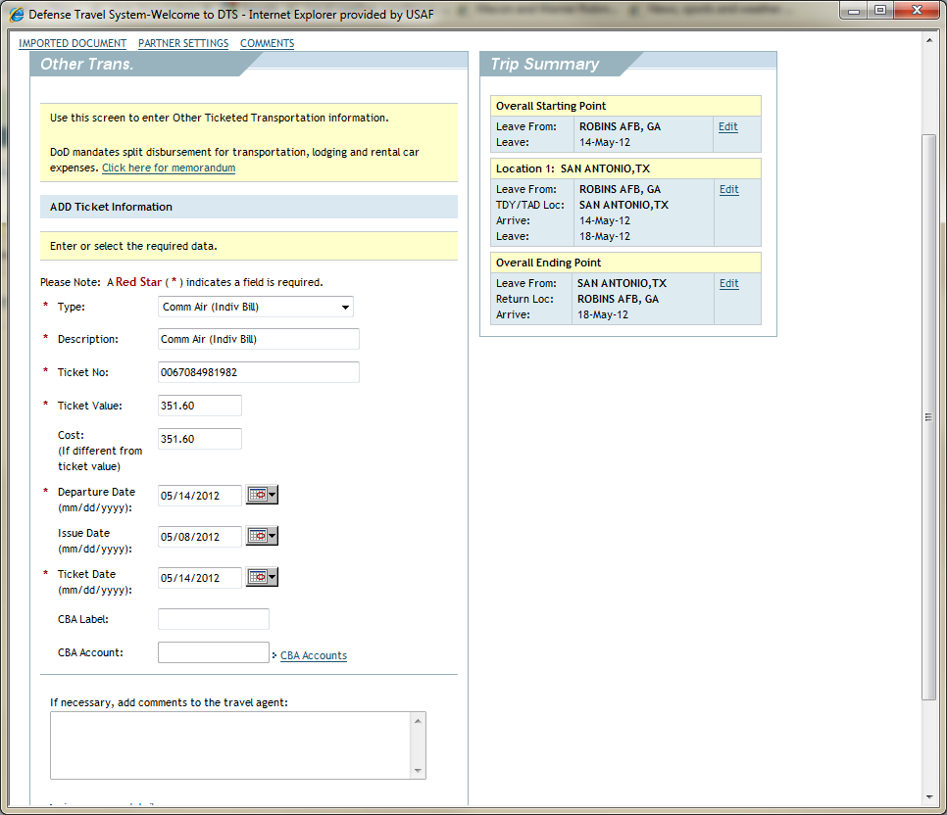
1
2
3
4
5
1. Type in E Ticket Number
2. Type in Ticket Cost
Appears on Voucher Copy Received via Email from RAFB AIRTRAK
3. Select the Departure , 4. Issue, and 5. Ticket Date from the Drop Down(s)
Notes:
23

Slide 24
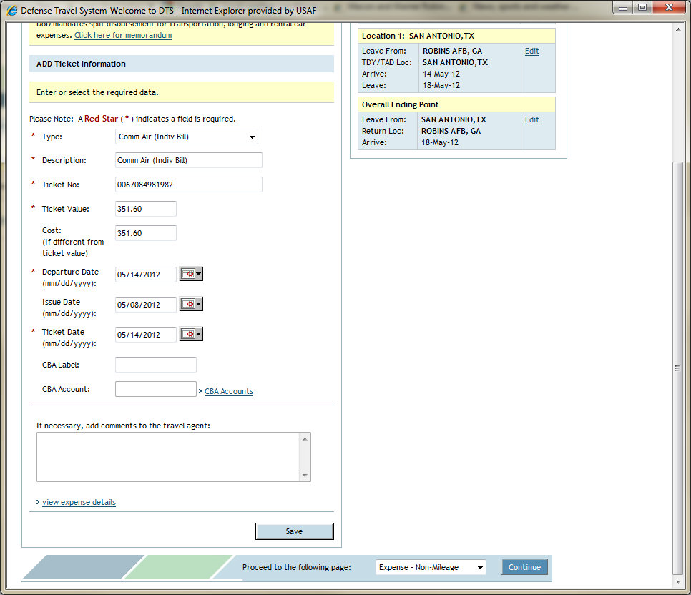
Select Save
Notes:
24

Slide 25
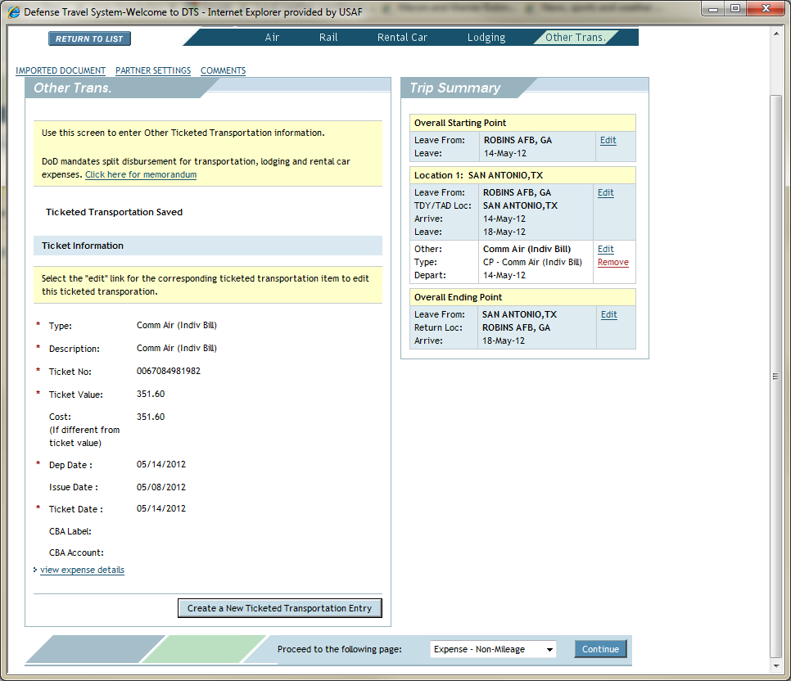
1
2
1. The Airline Ticket is Added to your Trip Summary
2. For CTO Fees, (Air Trak Fee) Select Create a New Ticketed Transportation Entry
Notes:
25

Slide 26
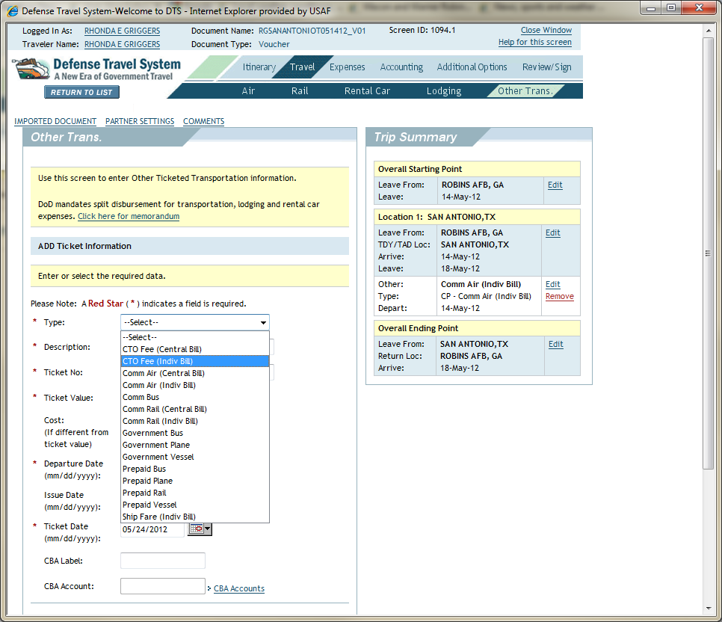
Select CTO Fee (Indiv Bill) from the Drop Down Menu
Notes:
26

Slide 27
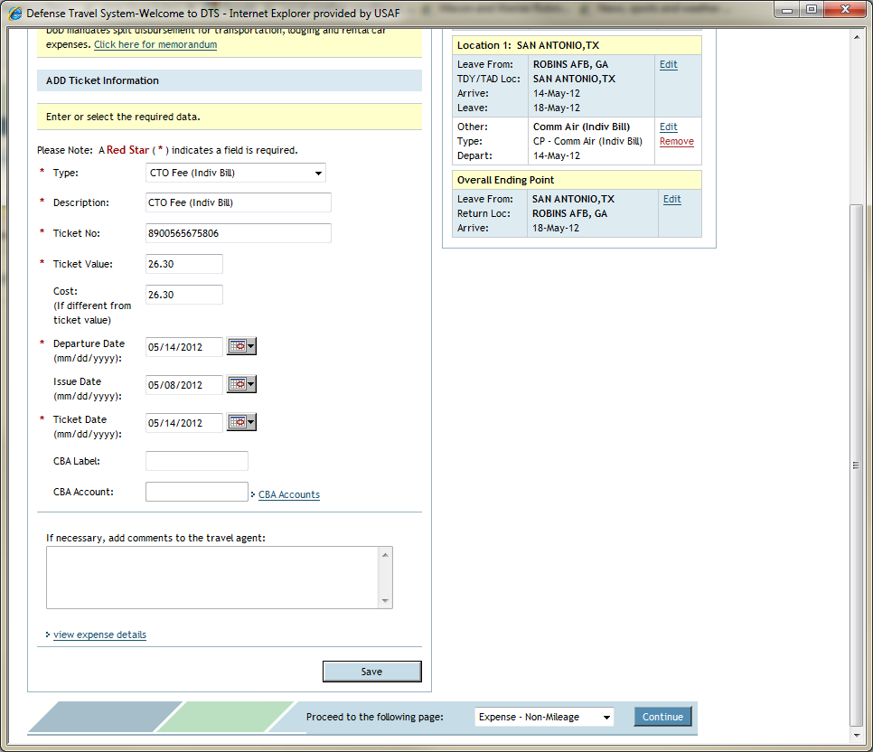
Type in the Amount of the CTO Fee

Slide 28
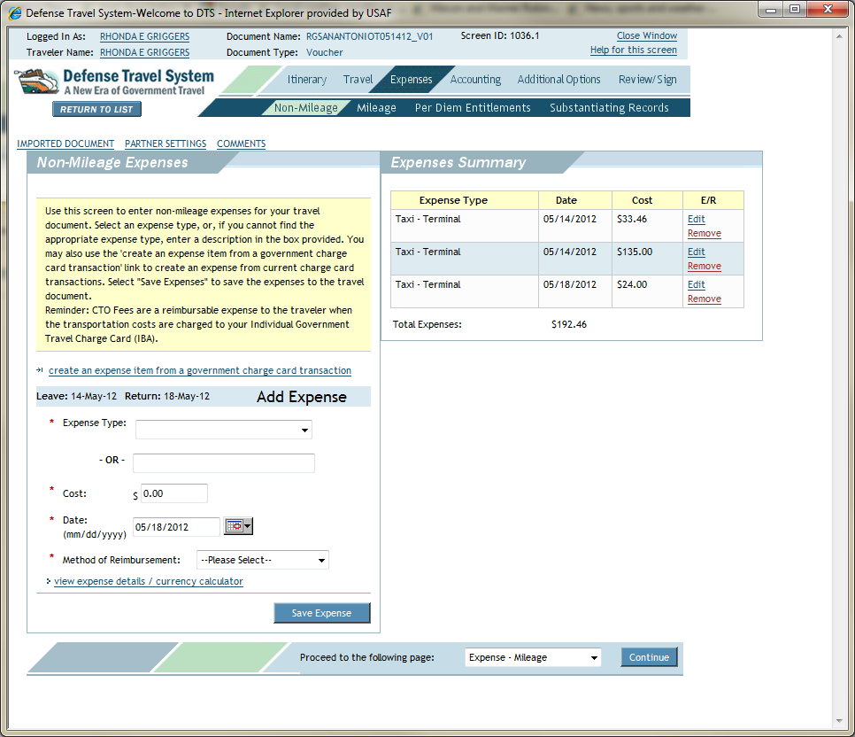
1
2
5
3
4
For Rental Car, 1. Select Expenses, 2. Non-Mileage
3. Select Expense Type from the Drop Down
4. Type in Cost
5. If the Charge was Posted to your GTC, you can Select Create an Expense Item from a Government Charge Card Transaction
Notes:
28

Slide 29
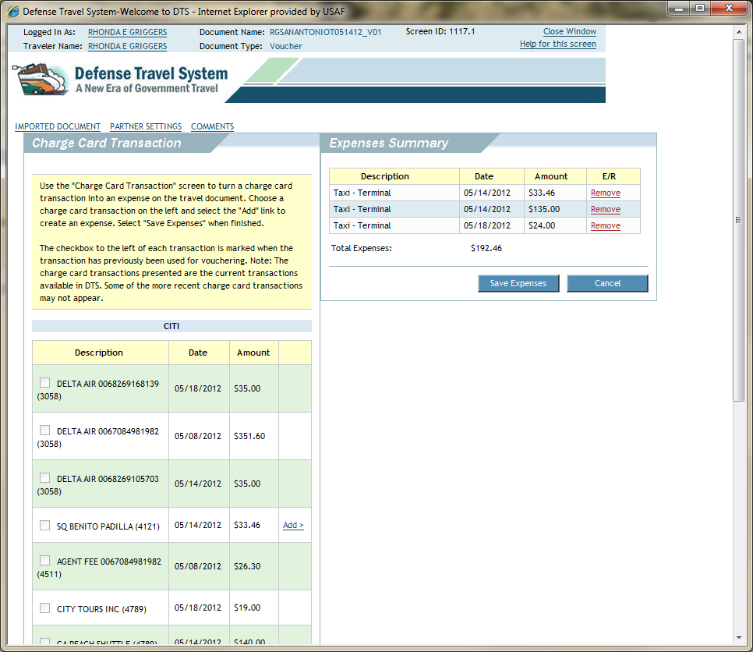
If the Add Button Appears you may Select the Box and “Pull it Over” to your Expense Screen
Notes:
29

Slide 30
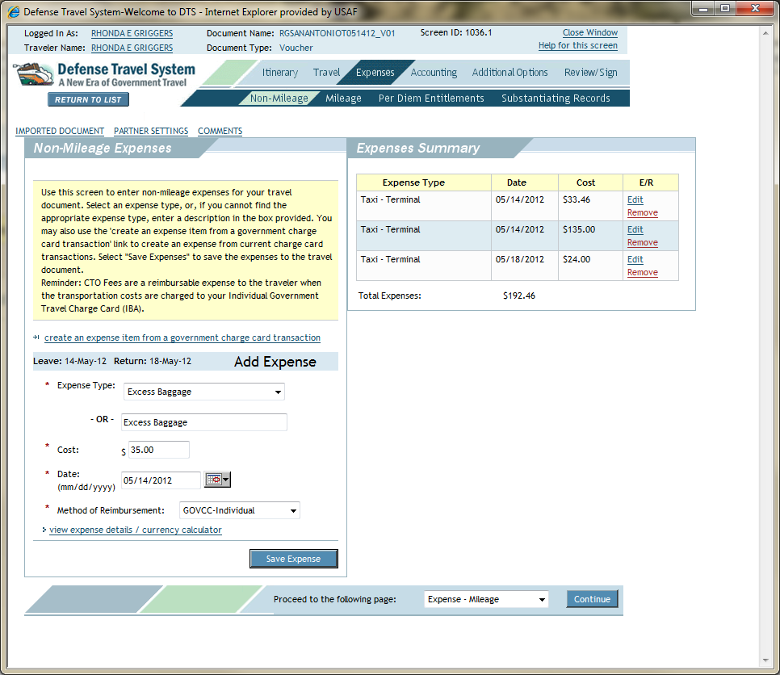
1
2
3
4
5
6
1. For Excess Baggage, (More than 1 Bag) Select Expenses, 2. Non-Mileage
3. Select Excess Baggage from the Drop Down
4. Type in Cost
5. Select the Date
6. Save Expense
Notes:
30

Slide 31
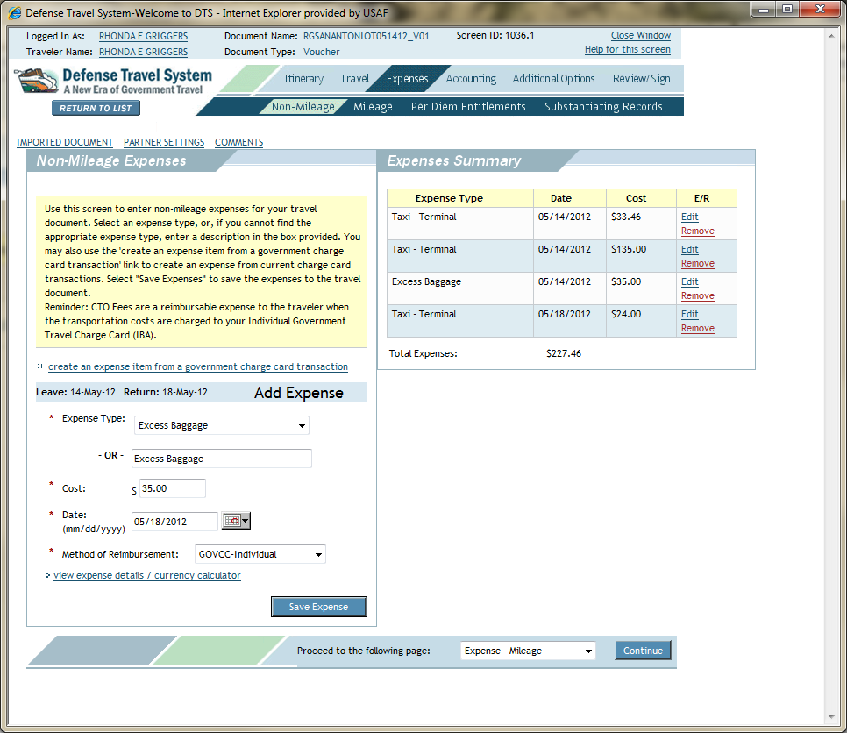
1
2
3
4
5
1. The Excess Baggage Appears in the Expenses Summary Box
For the Return Trip Excess Baggage, the Two Charges Must be Entered Separately
2. Select Excess Baggage
3. Type in the Cost
4. Select the Date
5. Save Expenses
Notes:
31

Slide 32
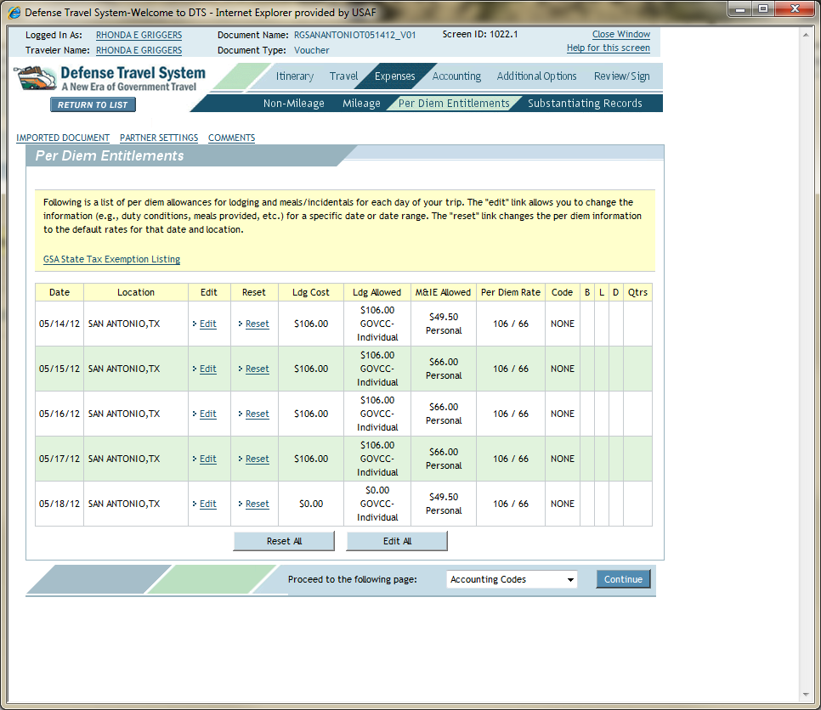
1
2
2
3
Per Diem Entitlements must be Validated
1. Select Per Diem Entitlements
2. Your Per Diem Entitlements will Appear Daily (Lodging Cost, Meals & Incidentals (M&I))
For this Example a Deduction is Made for Lunch Each Day of $16.00
3. Select Edit for the First Day of the Change
Notes:
32

Slide 33
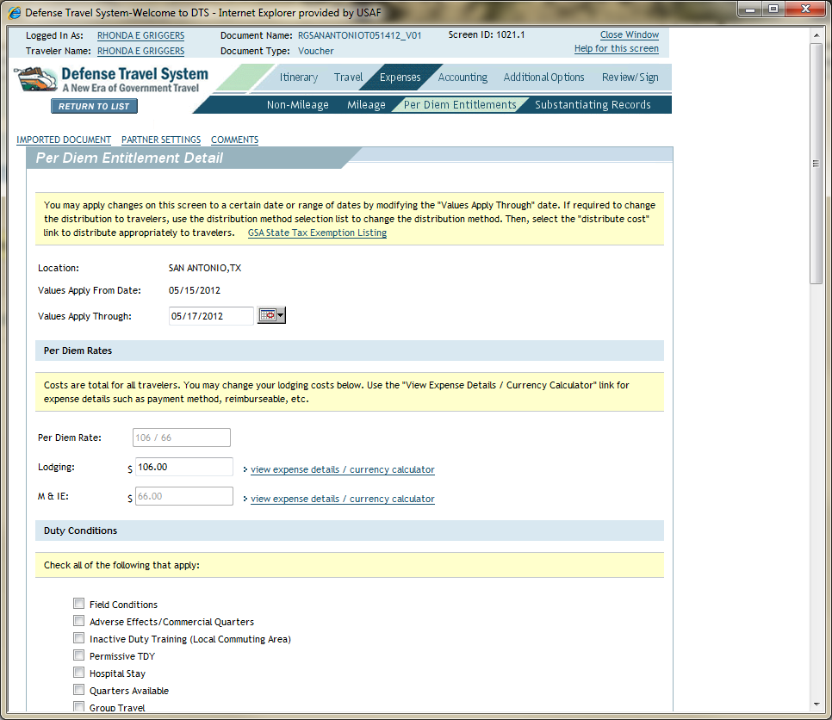
2
1
The Per Diem Entitlements Detail Screen Appears
1. Select the Dates that Apply (15-17 May 2012)
2. Scroll Down

Slide 34
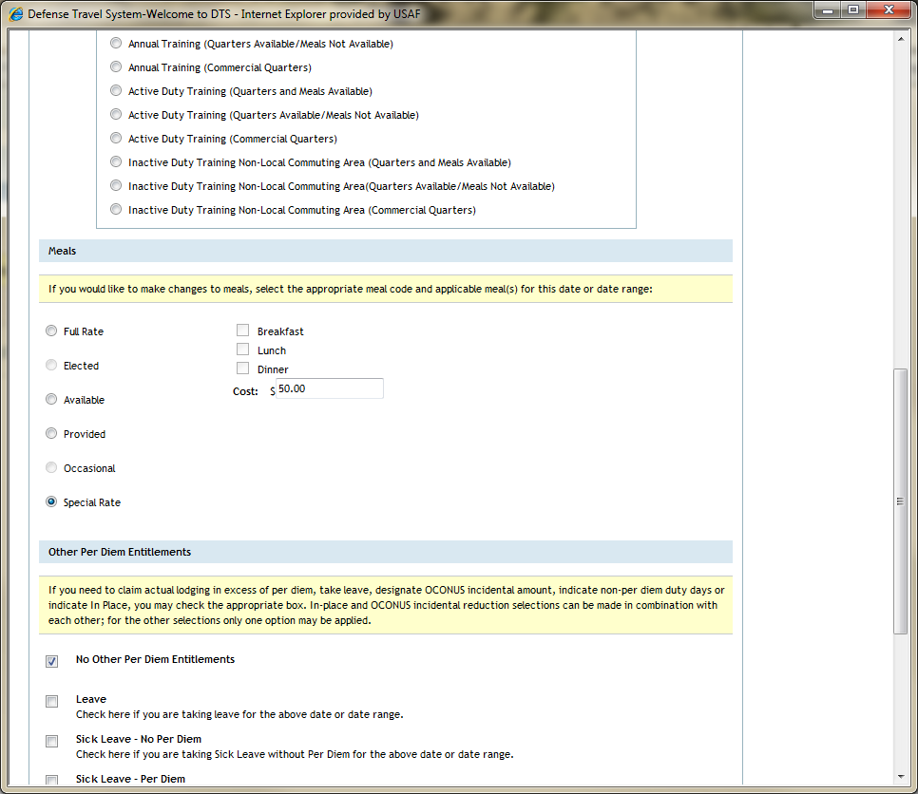
1
2
1
3
1. Under Meals, Select Special Rate
2. Type in the Amount
(Per Diem was $66.00 - $16.00 = $50.00)
3. Save Bottom of Page
Notes:
34

Slide 35
The Per Diem Entitlements for M&I are Reduced for all Three Days
Notes:
35

Slide 36
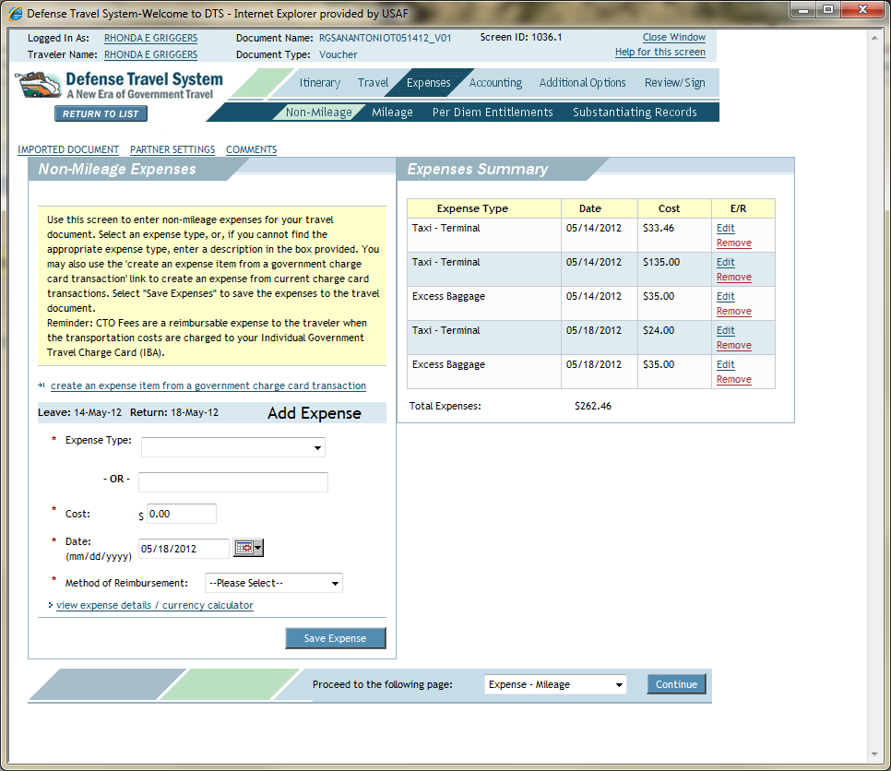
1
2
1. For Hotel Taxes, Select Expenses
2. Select Non- Mileage
Notes:
36

Slide 37
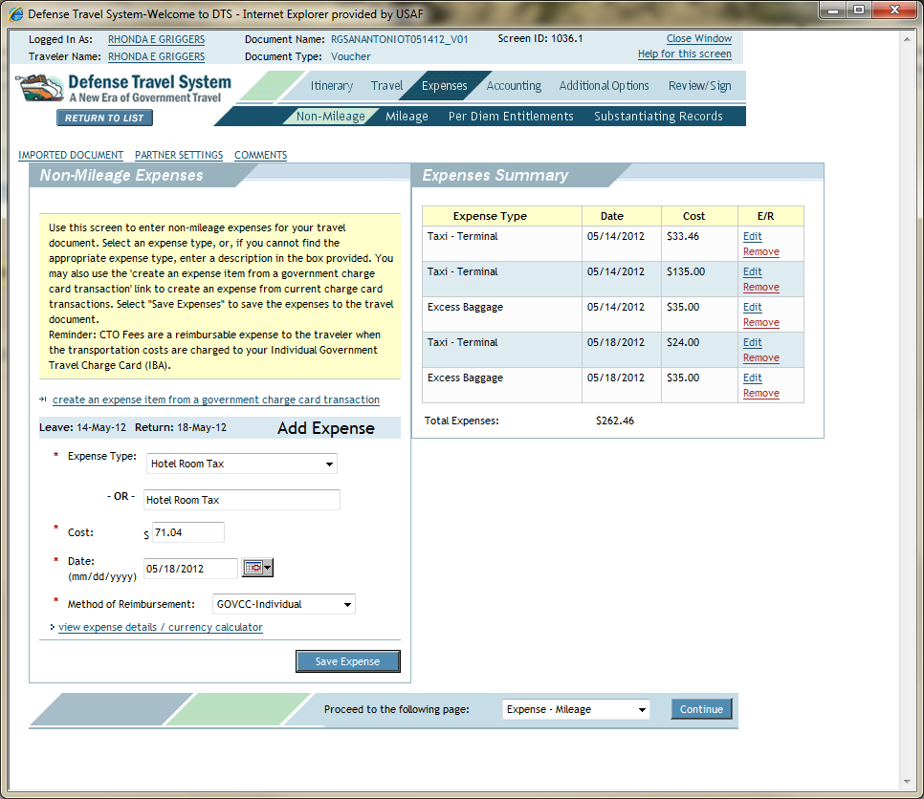
Taxes can be Entered in One Lump Sum
Notes:
37

Slide 38
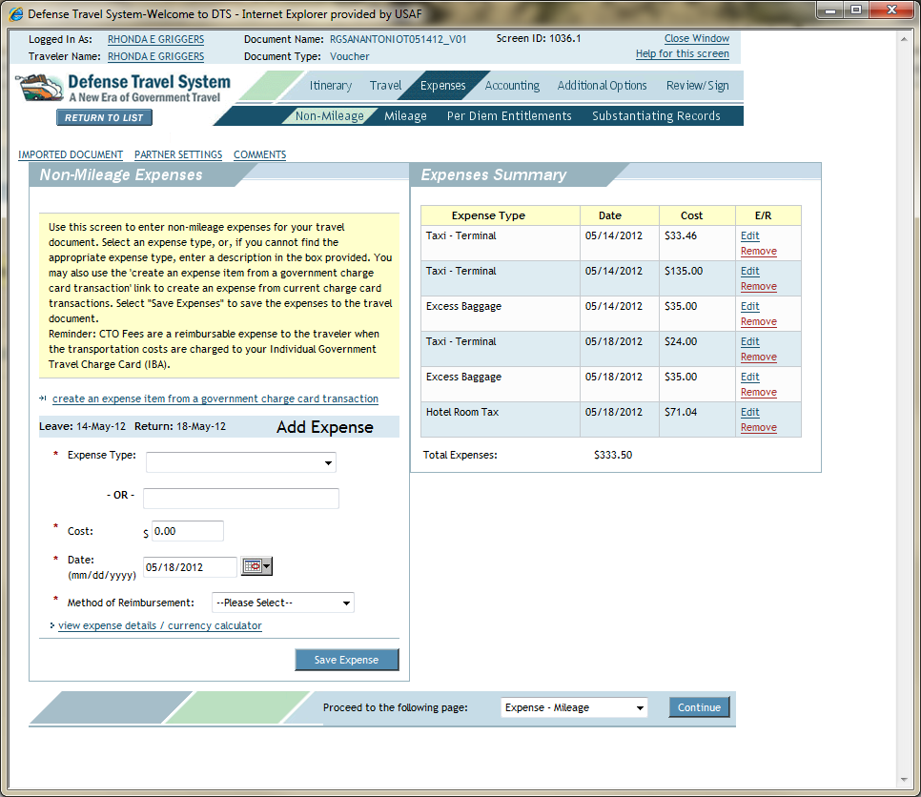
Your Hotel Room Tax Appears in the Expenses Summary Box

Slide 39
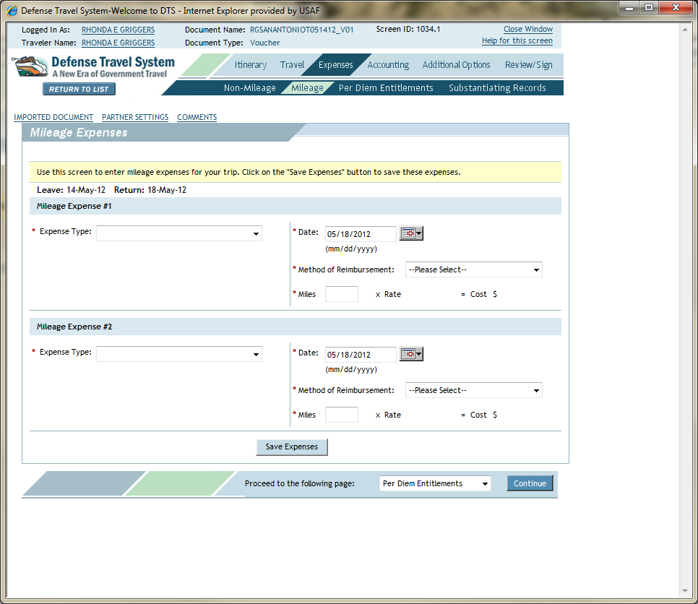
1
2
Drove POC to Atlanta Airport
1. Click Expenses
2. Select Mileage
Notes:
39

Slide 40
1
2
3
4
5
6
7
8
9
1. Select Expense Type and 2. Departure Date
3. Method of Reimbursement
4. Miles
5. Select Expense Type and 6. Return Date
7. Method of Reimbursement
8. Miles
9. Save Expenses
Notes:
40

Slide 41
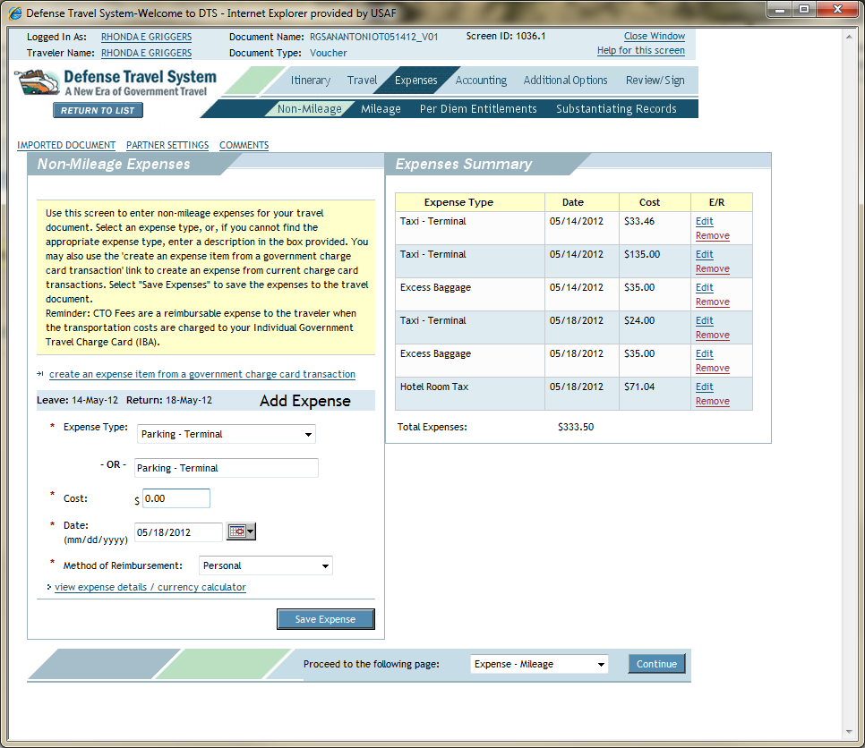
1
2
3
4
5
6
7
Airport Parking 1. Select Expenses 2. Non-Mileage
3. Select Expense Type
4. Cost
5. Date
6. Method of Reimbursement
7. Save Expense

Slide 42
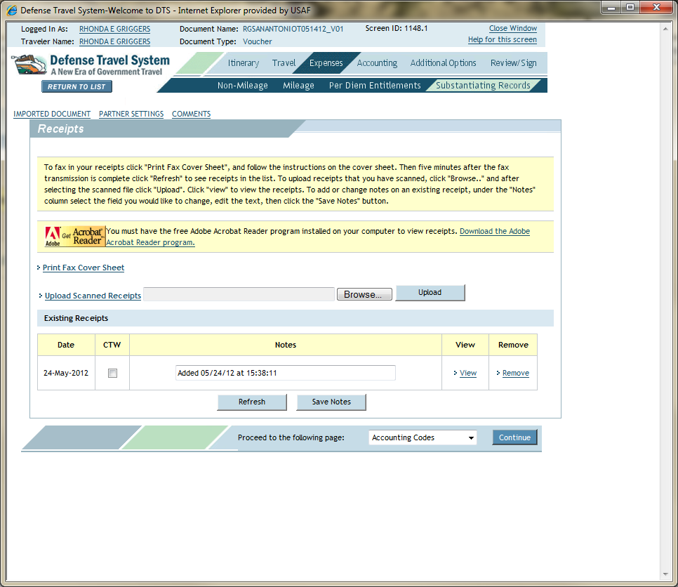
1
2
All Receipts of $75 or More Must be Uploaded
Scan Receipts and Save to your Hard Drive
1. Select Expenses
2. Select Substantiating Records
Notes:
42

Slide 43
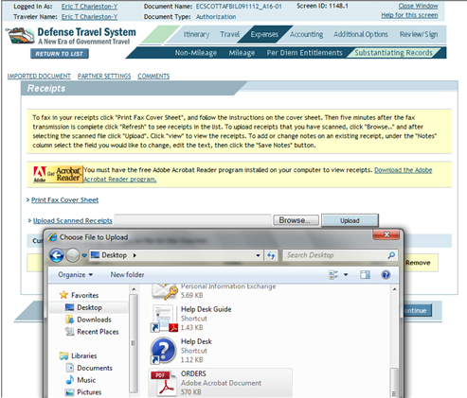
1
3
2
2. Upload screen
4
1. Select Browse
2. Select the File (Receipt) to Upload
3. Select Upload
4. Change the Name of your Receipt to a Descriptive Identifier in the Notes Section
Notes:
43

Slide 44
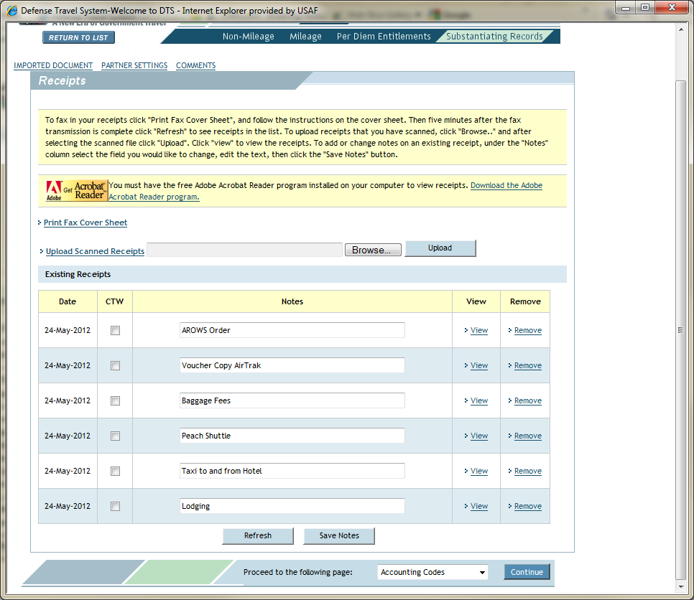
All Documents are Uploaded and Titles Changed
Select Continue
Notes:
44

Slide 45
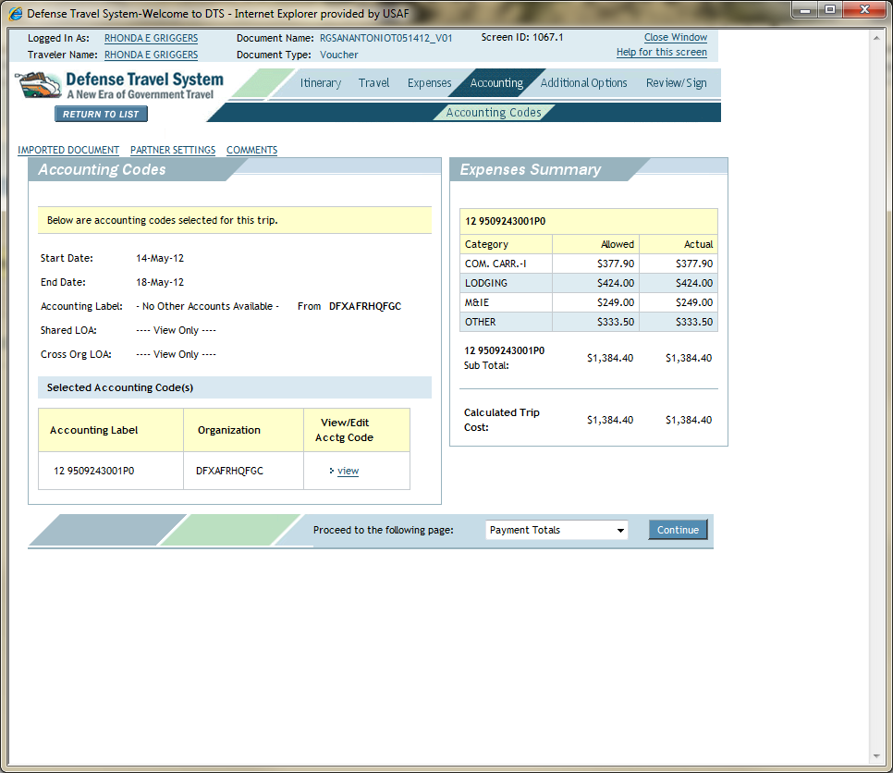
1
2
2
Optional
To Check the Totals of Accounting
1. Select Accounting
2. View Expenses Summary Box
Notes:
45

Slide 46
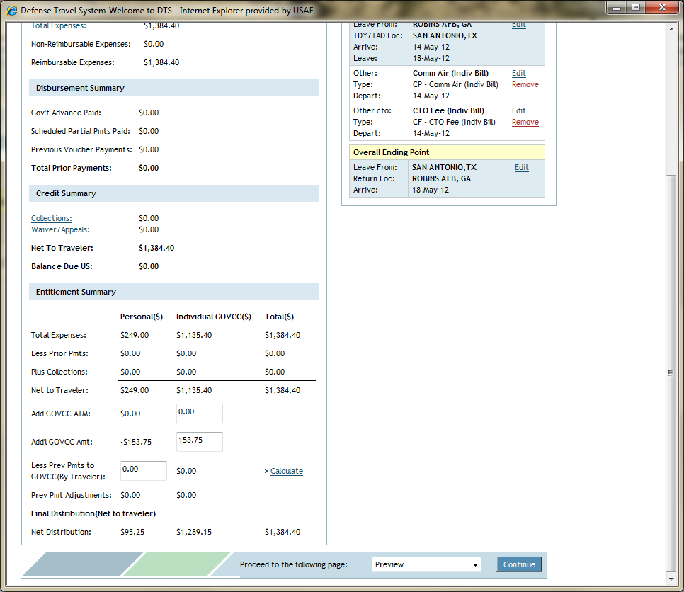
1
2
3
4
1. To Add Amounts to your GTC
2. Type in the Amount to Add
3. Select Calculate
4. Select Continue
Notes:
46

Slide 47
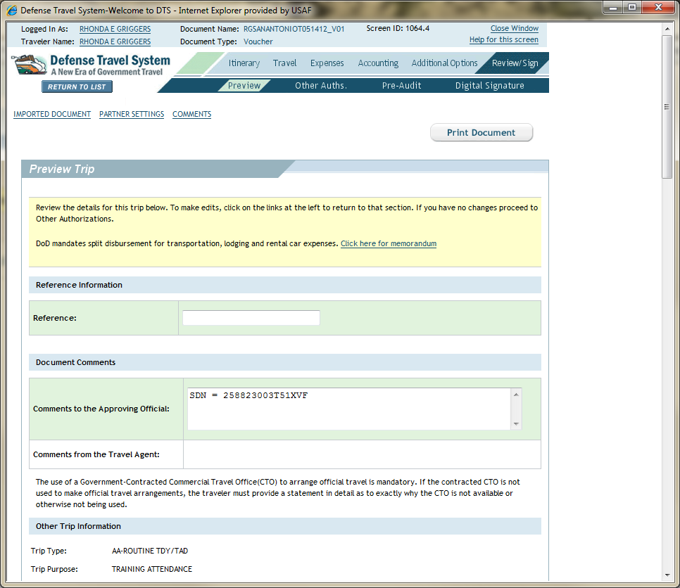
1
2
1. The Preview will Appear
2. Scroll Down

Slide 48
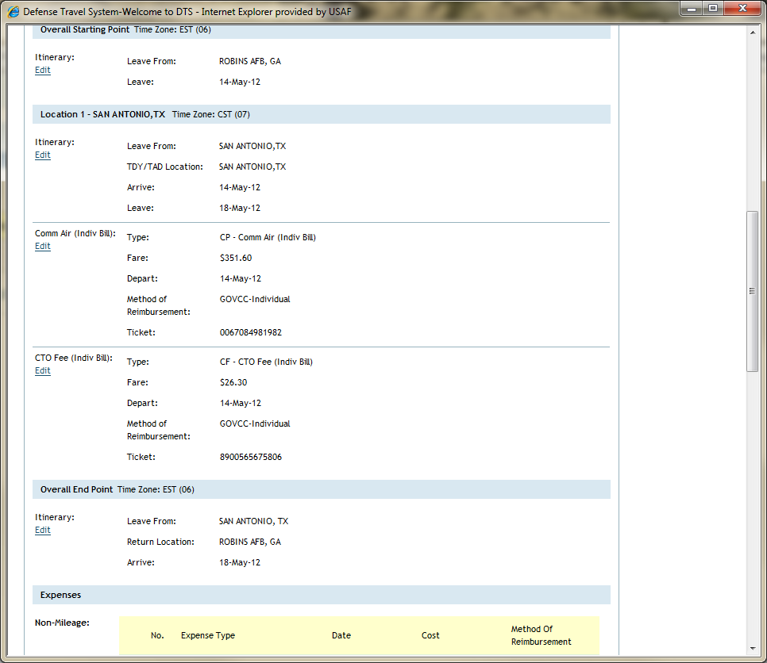
Review your Itinerary, Expenses

Slide 49
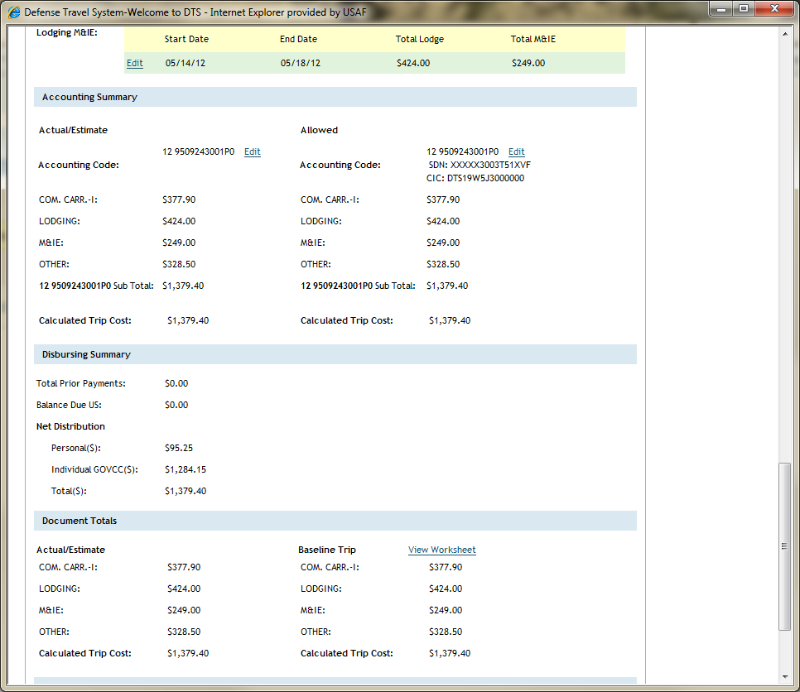
Review and Sign
Notes:
49

Slide 50
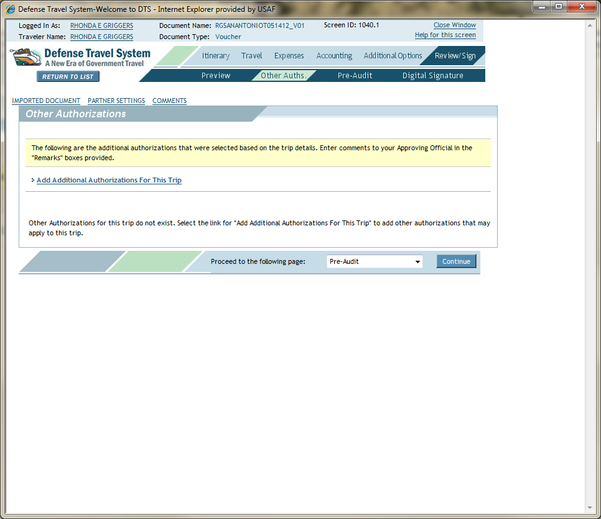
Continue
Notes:
50

Slide 51
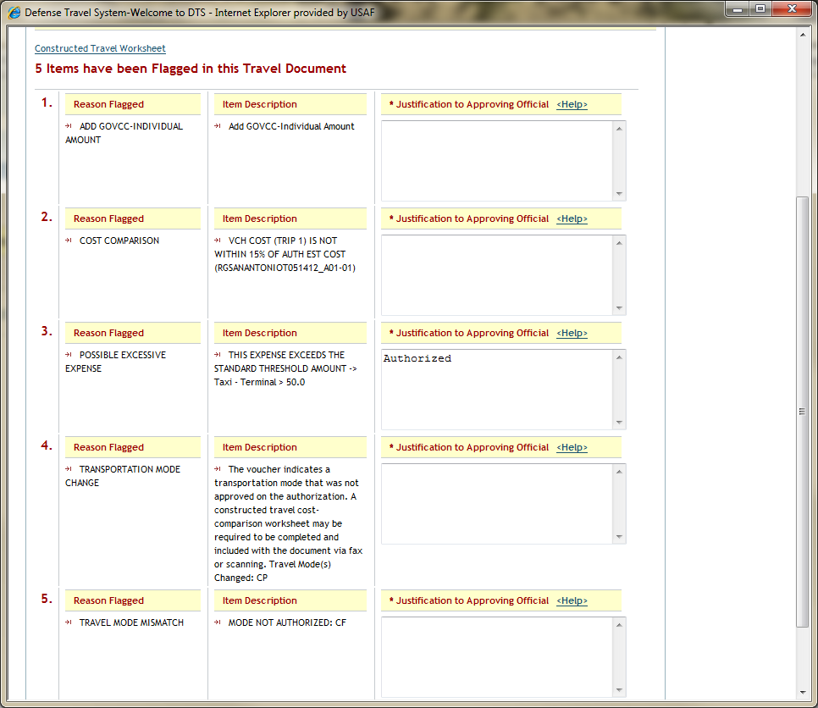
Any Flagged Items must be Justified
Type in “Authorized” or Another Justification
See Next Page for Examples
Notes:
51

Slide 52
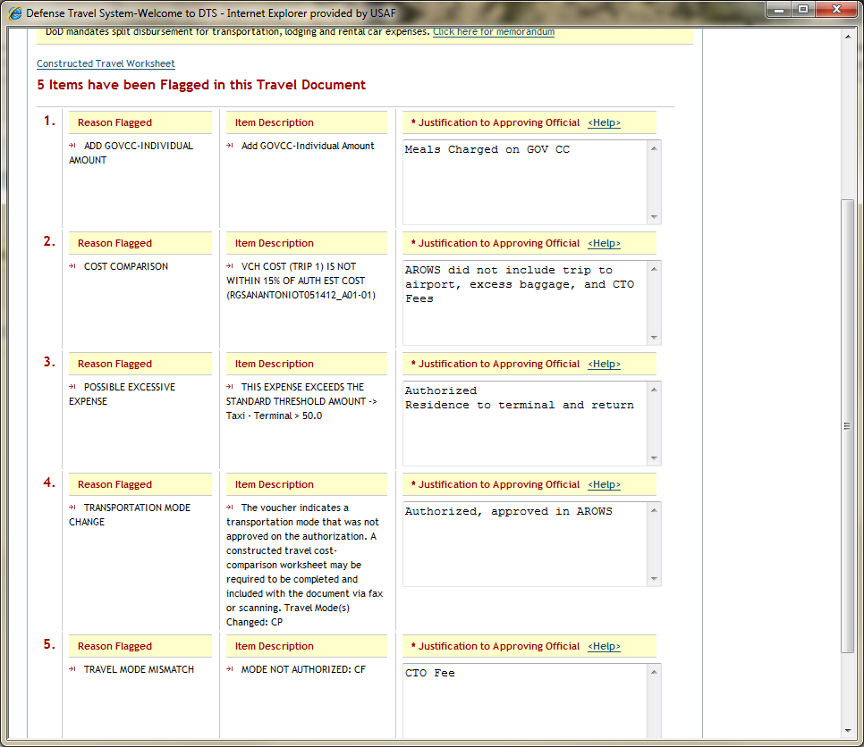
For this Example the Justifications are Typed
Notes:
52

Slide 53
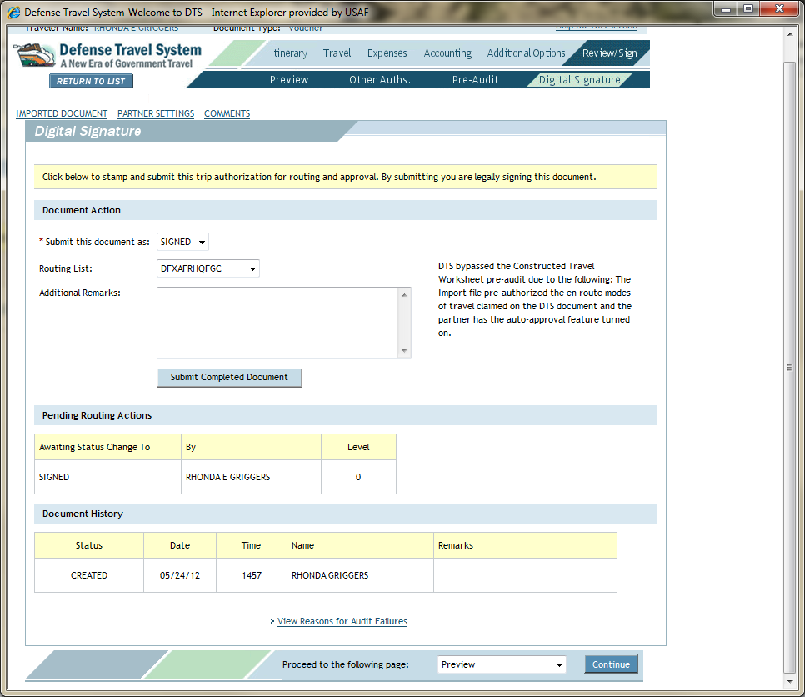
Submit Completed Document
Notes:
53

Slide 54
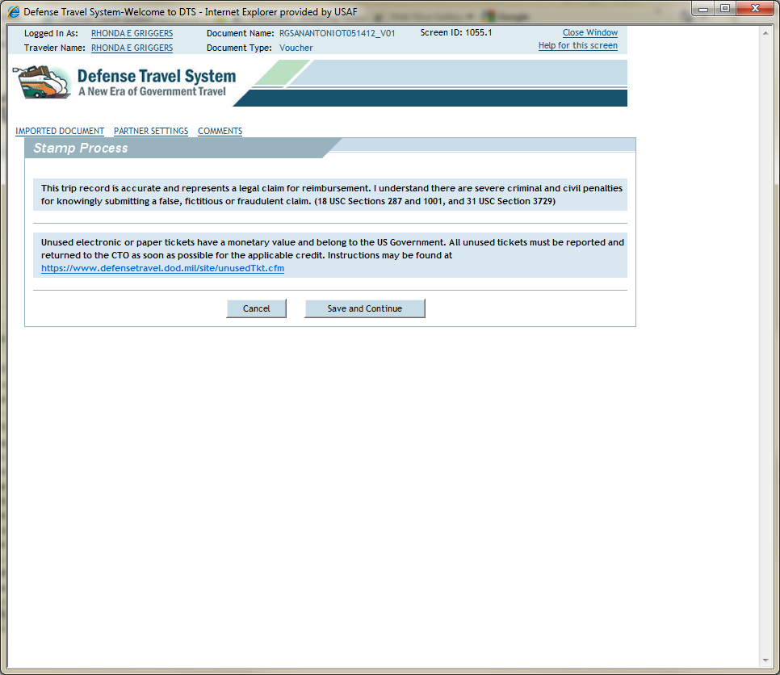
Save And Continue

Slide 55
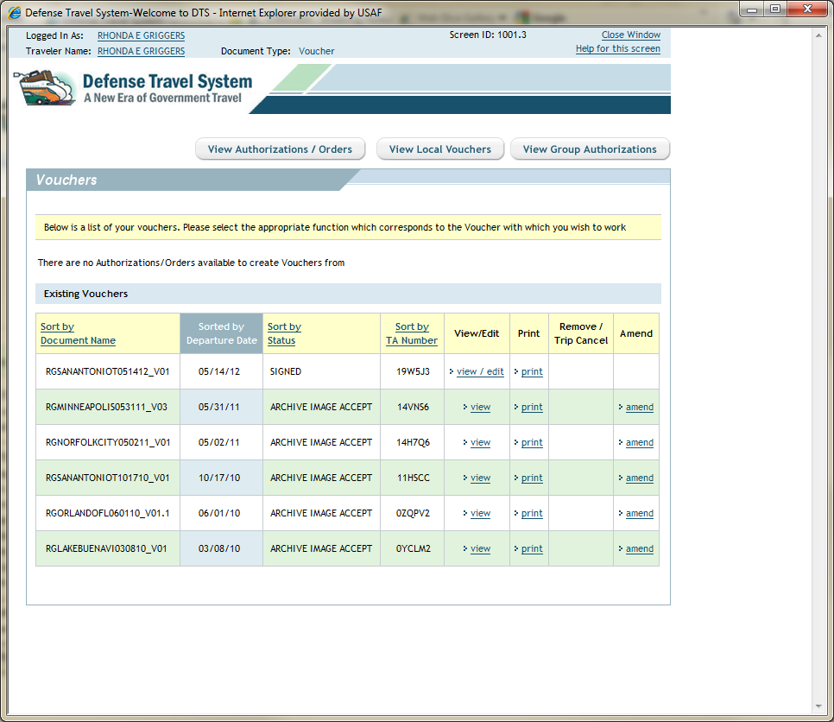
1
2
1. The Voucher you Created will Read “Signed”
To Check On Status or the Voucher Stage
2. Click view/edit
Notes:
55

Slide 56
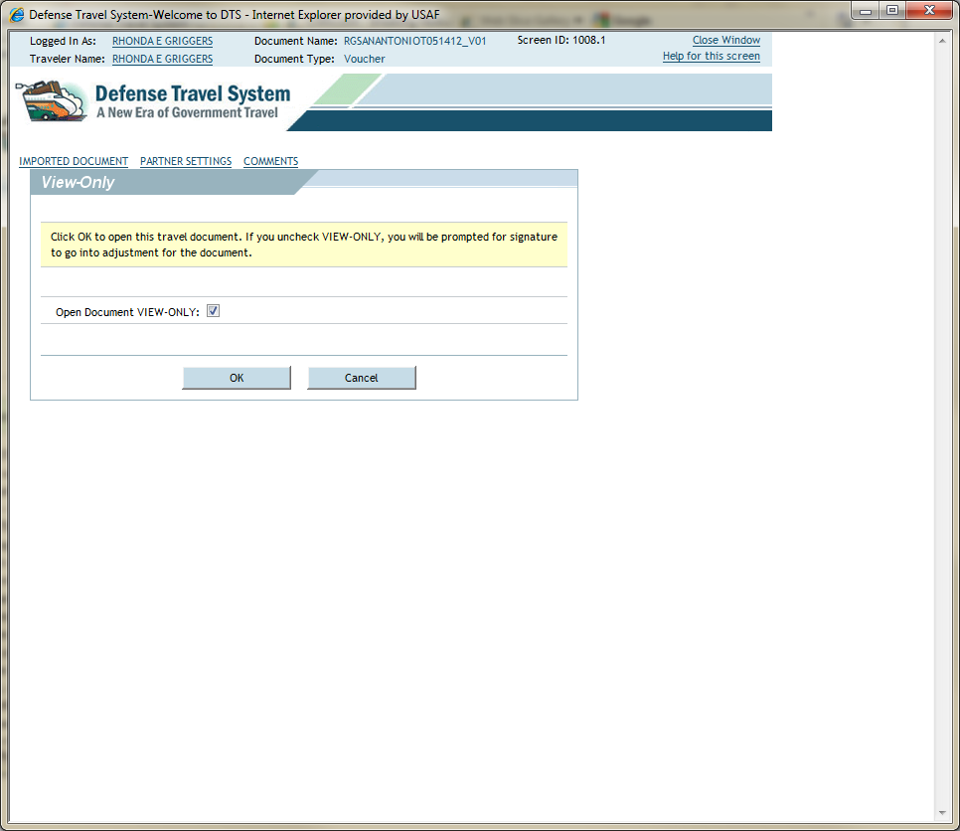
1
2
1. View-Only, Box is Checked
2. Click Ok
Notes:
56

Slide 57
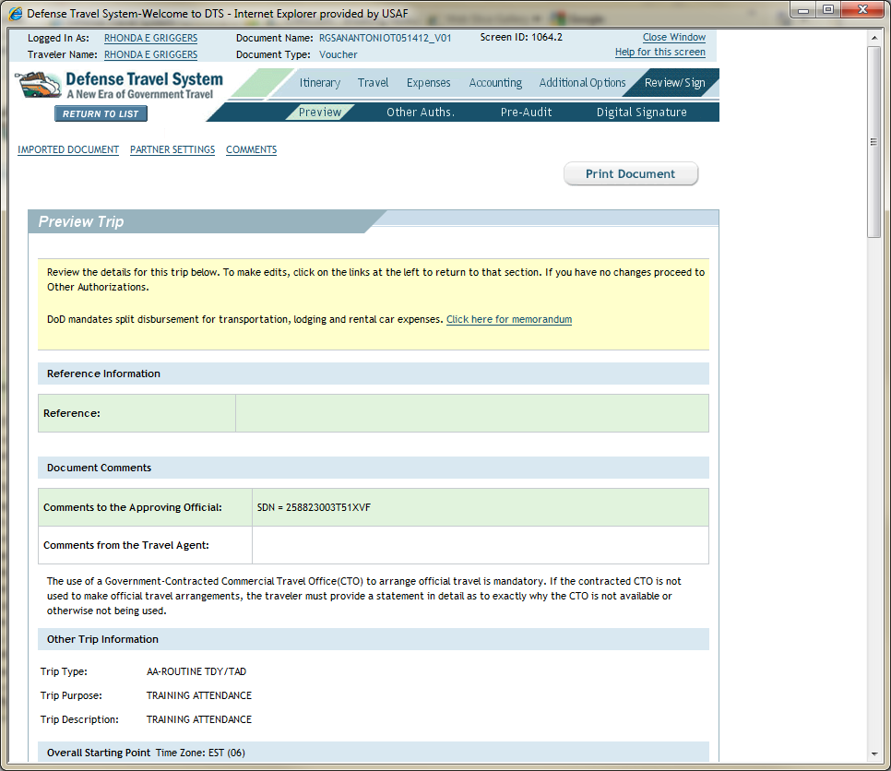
Click Digital Signature
Notes:
57

Slide 58
Review and Approval Level
Notes:
58

Slide 59
Review and Approval Level
After Supervisory Approval – Member Receives Email Notification
DTS Pays Out – Member Receives Email Notification
Notes:
59

